Slide 1
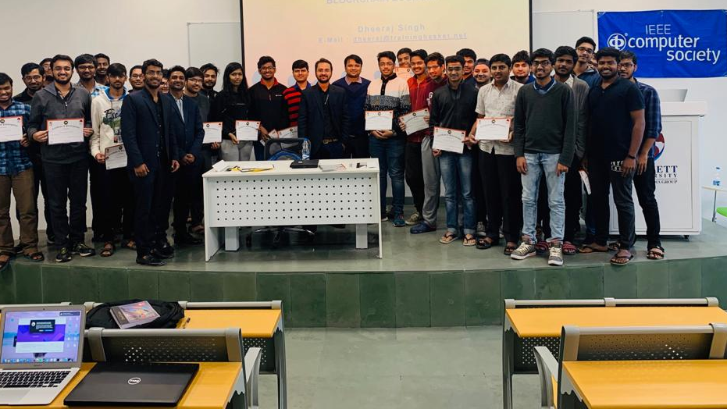

DigiKalam
ECSE205L - Spring 2020
Pulkit Vyas - E19CSE284
Chirag Saxena - E19CSE124
Yash Agarwal - E19CSE156
Sanyam Sinha - E19CSE188
Vedic Tak - E19CSE044

Slide 2
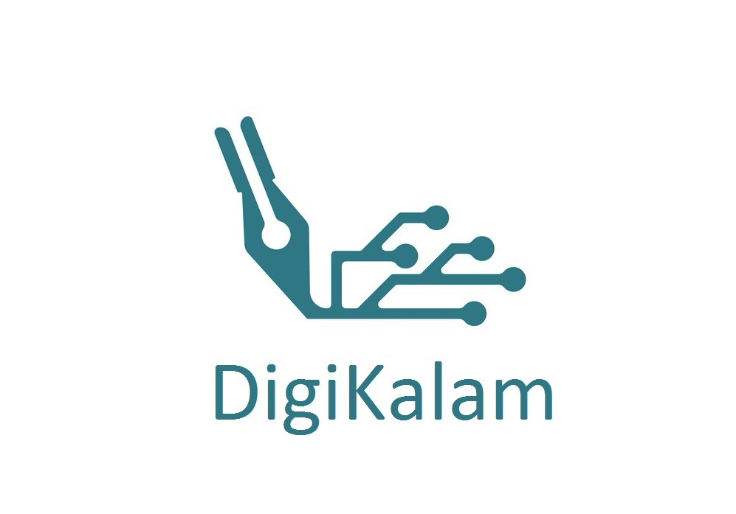

Contents
Introduction
Problem
Solution
Software Requirements
Tech utilized

Slide 3
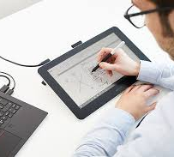
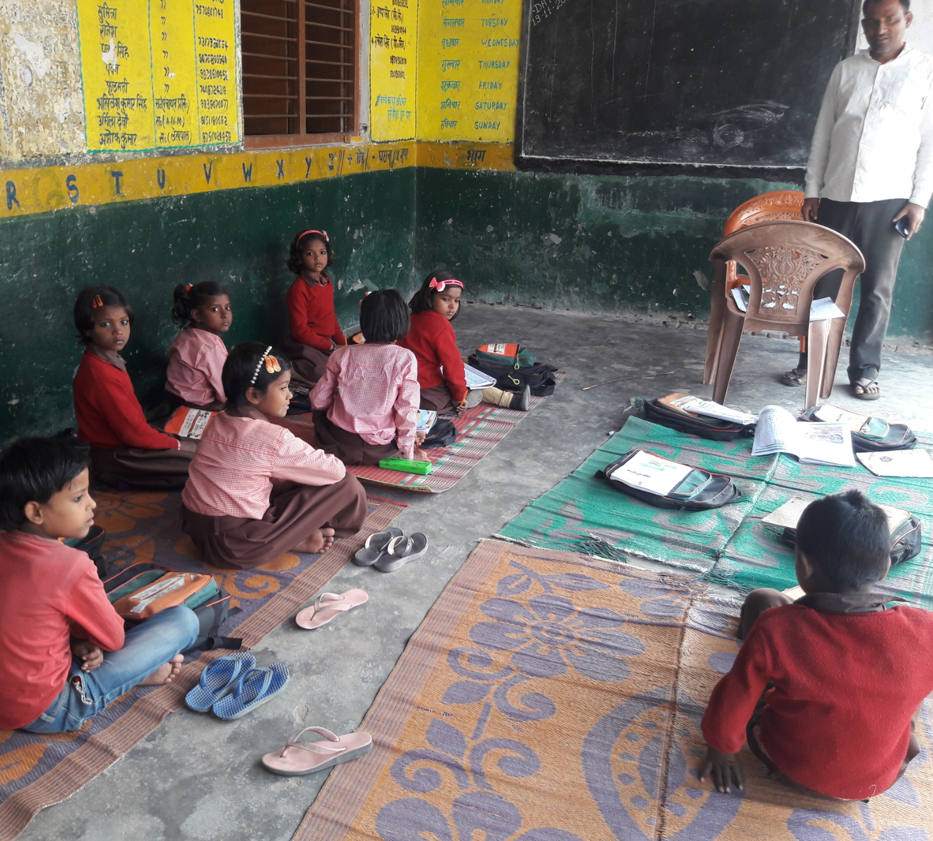
Introduction
The conventional way of learning not possible to follow in the virtual mode, while it was new for everybody but places with less advancement in technology are harder hit.
There are hardware and software available, but they require some technical knowledge and sophisticated devices for the same

Slide 4

Problem
The lockdown has led to many adversities and a major one was on the education system. Many concepts can't be explained theoretically or by slides. These problems are more severe in areas with less access to the internet and which lack the required resources.

Slide 5
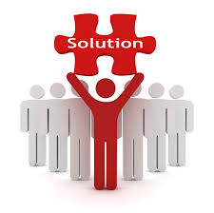
Solution
DigiKalam solves the problem by providing a user friendly, and less on hardware requirement solution for real-time note making and online "pen and paper" like service
Only requires a phone's camera, paper and pen
The easily accessible and free webapp can be easily be used side by side with other softwares used for meeting by the teacher

Slide 6
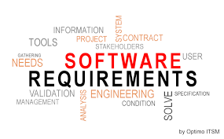
Software Requirements
DigiKalam would require:
A Camera (smartphone's camera would work)
A sheet of paper
A pen
Stable Internet connection
A windows laptop (optional)

Slide 7




Tech/Resources utilized
Image Processing : Python and python libraries like OpenCV, matplotlib, Scikit etc.
Canvas : ReactJS , NodeJS, ExpressJS etc.

Slide 8
Feedback
Rachna Saxena (Industry, Teacher): "The requirement and the possibilities of the software to scale up the idea are immense"
Meghna Sharma (Friend): "The idea is unique and something like this using pen and paper is new looking forward for its development"
Deepak Tak (IT Industry): "The idea is good, and I have never heard of that type of project by 2nd year student. There is a product named Google Board which is used by people this will show what you are writing on the board and your video too on the computer screen. But your project is economical and good. That will be used by many private teachers who could not spend much like the institute teachers they don’t have much resources, hence they are also not able to show their skills, your project will help those instructors, teachers and that could be much more helpful to the architects. They could develop their structure on paper pen and that will be displayed on their screen, the small starting of the projects can be done like this. For us it is not much helpful, but in a way, it could reduce our screen time, like we can do writing work on paper and that will be converted to the digital, and in meetings we can use them"

Slide 9
Acknowledgement
We would like to express our gratitude to Dr. Anurag and Dr. Rahul for providing us with this opportunity of applying our understanding of the software engineering course in a practical setting with this project and advising and mentoring us.

Slide 10
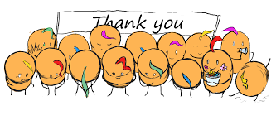
Thank You

